Slide 1
DATA ANALYTICS USING SQL SERVER
BY ANUBHAV JANA

Slide 2
INTRODUCTION TO DATA WAREHOUSE DEVELOPMENT
In computing, a data warehouse (DW or DWH), also known as an enterprise data warehouse (EDW), is a system used for reporting and data analysis, and is considered a core component of business intelligence. DWs are central repositories of integrated data from one or more disparate sources. They store current and historical data in one single place that are used for creating analytical reports for workers throughout the enterprise.

Slide 3
WHAT IS OLTP AND OLAP ?
We can divide IT systems into transactional (OLTP) and analytical (OLAP). In general we can assume that OLTP systems provide source data to data warehouses, whereas OLAP systems help to analyze it.
OLTP (On-line Transaction Processing) is characterized by a large number of short on-line transactions (INSERT, UPDATE, DELETE).
OLAP (On-line Analytical Processing) is characterized by relatively low volume of transactions. Queries are often very complex and involve aggregations.

Slide 4
OLTP-OLAP
In OLTP database there is detailed and current data, and schema used to store transactional databases is the entity model (usually 3NF).
OLAP applications are widely used by Data Mining techniques. In OLAP database there is aggregated, historical data, stored in multi-dimensional schemas (usually star schema).

Slide 5
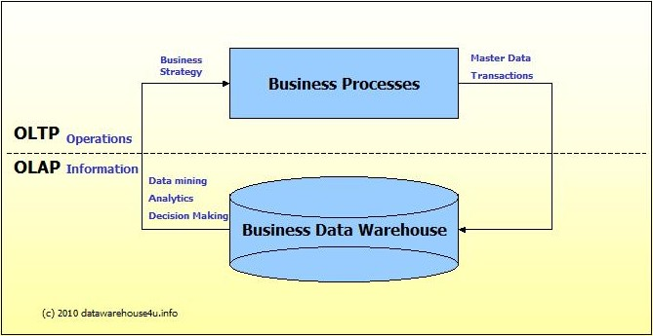
SCHEMATIC REPRESENTATION

Slide 6
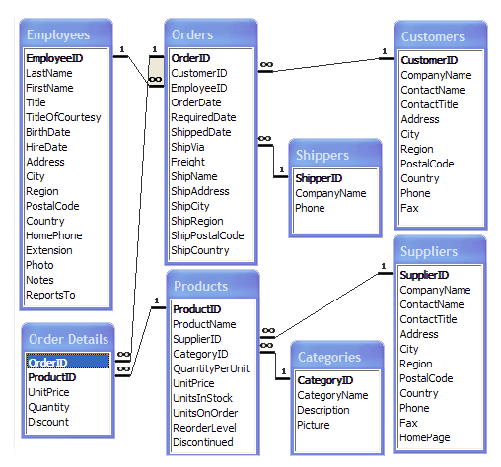
NORTHWIND OLTP DATABASE

Slide 7
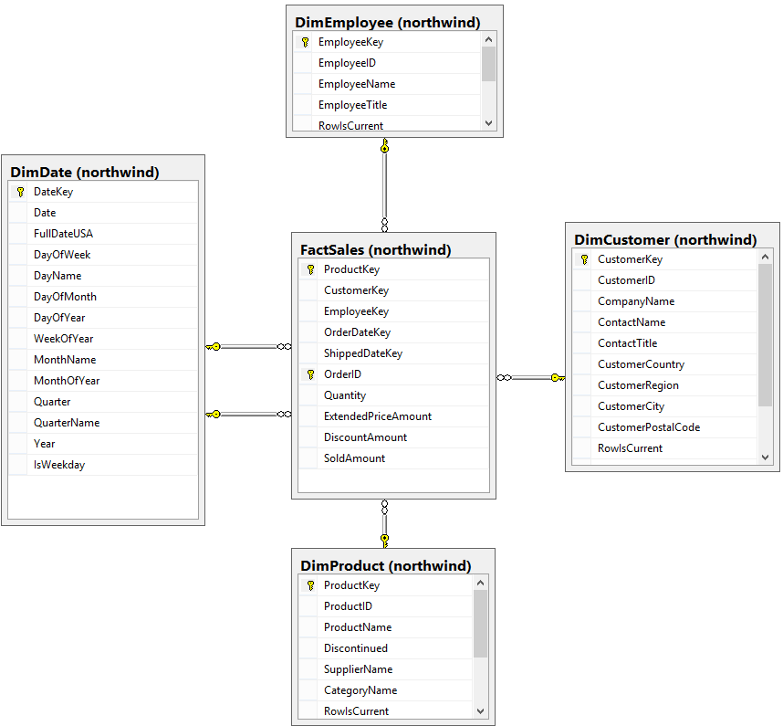
NORTHWIND DATAMART(DIMENSIONAL MODEL)

Slide 8
CREATING A SCHEMA AND TABLE
CREATE SCHEMA REF
GO;
CREATE TABLE REF.DIM_CUSTOMER(CUSTOMERID NCHAR(5) CONSTRAINT pk_cid PRIMARY KEY NOT NULL,COMPANYNAME NVARCHAR(40) NOT NULL,CONTACTNAME NVARCHAR(30),CONTACTTITLE NVARCHAR(30),ADDRESS NVARCHAR(60),CITY NVARCHAR(15),REGION NVARCHAR(15),POSTALCODE NVARCHAR(10),COUNTRY NVARCHAR(15),PHONE NVARCHAR(24),FAX NVARCHAR(24),CUSTOMERKEY INT NOT NULL)

Slide 9
SNAP FROM MANAGEMENT STUDIO

Slide 10

ADDING PRIMARY AND FOREIGN KEY

Slide 11
FOREIGN KEY CONSTRAINT

Slide 12
PRIMARY AND FOREIGN KEY
Primary key (PK) of the table enforces the entity integrity of the table because primary key constraints guarantee unique data.
In a foreign key reference, a link is created between two tables when the column or columns that hold the primary key value for one table are referenced by the column or columns in another table. This column becomes a foreign key in the second table.

Slide 13
GENERATED SCRIPT
USE [DemoDB]
GO
/****** Object: Table [dbo].[DimCustomer] Script Date: 10-05-2018 10:46:00 ******/
SET ANSI_NULLS ON
GO
SET QUOTED_IDENTIFIER ON
GO
SET ANSI_PADDING ON
GO
CREATE TABLE [dbo].[DimCustomer](
[CustomerKey] [int] NOT NULL,
[CustomerID] [int] NULL,
[CompanyName] [varchar](50) NULL,
[ContactName] [varchar](50) NULL,
[ContactTitle] [varchar](50) NULL,
[CustomerCountry] [varchar](50) NULL,
[CustomerRegion] [varchar](50) NULL,
[CustomerCity] [varchar](50) NULL,
[CustomerPostalCode] [int] NULL,
[CustomerAddress] [varchar](50) NULL,
[CustomerPhone] [int] NULL,
[CustomerFax] [int] NULL,
CONSTRAINT [PK_DimCustomer] PRIMARY KEY CLUSTERED
(
[CustomerKey] ASC
)WITH (PAD_INDEX = OFF, STATISTICS_NORECOMPUTE = OFF, IGNORE_DUP_KEY = OFF, ALLOW_ROW_LOCKS = ON, ALLOW_PAGE_LOCKS = ON) ON [PRIMARY]
) ON [PRIMARY]
GO
SET ANSI_PADDING OFF

Slide 14
SCRIPT
SET ANSI_NULLS ON
GO
SET QUOTED_IDENTIFIER ON
GO
SET ANSI_PADDING ON
GO
CREATE TABLE [dbo].[DimDate](
[DateKey] [date] NOT NULL,
[Date] [date] NULL,
[FullDateUSA] [date] NULL,
[DayOfWeek] [int] NULL,
[DayName] [varchar](50) NULL,
[DayOfMonth] [int] NULL,
[DayOfYear] [int] NULL,
[WeekOfYear] [int] NULL,
[MonthName] [varchar](50) NULL,
[MonthOfYear] [varchar](50) NULL,
[Quarter] [int] NULL,
[QuarterName] [varchar](50) NULL,
[Year] [int] NULL,
[IsWeekday] [char](10) NULL,
CONSTRAINT [PK_DimDate] PRIMARY KEY CLUSTERED
(
[DateKey] ASC
)WITH (PAD_INDEX = OFF, STATISTICS_NORECOMPUTE = OFF, IGNORE_DUP_KEY = OFF, ALLOW_ROW_LOCKS = ON, ALLOW_PAGE_LOCKS = ON) ON [PRIMARY]
) ON [PRIMARY]

Slide 15
COMMON TABLE EXPRESSION(CTE)
Specifies a temporary named result set, known as a common table expression (CTE). This is derived from a simple query and defined within the execution scope of a single SELECT, INSERT, UPDATE, or DELETE statement.

Slide 16
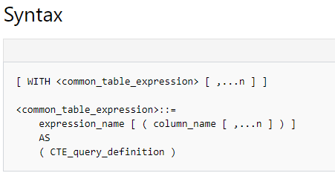
SYNTAX OF CTE

Slide 17
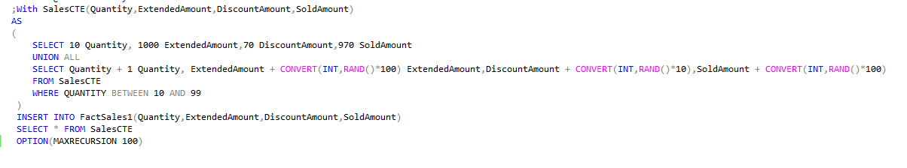
IMPLEMENTING CTE

Slide 18
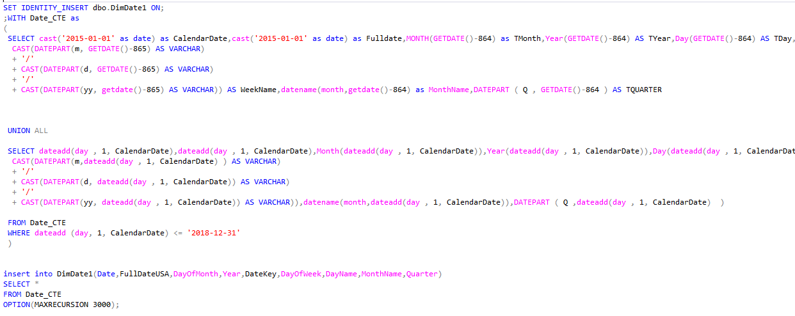
INSERTING DATES USING CTE

Slide 19
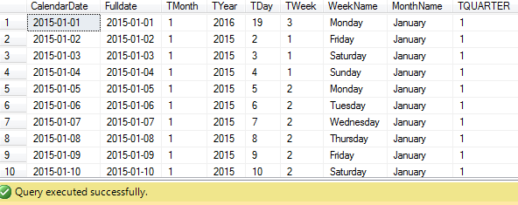
DISPLAYING THE CTE RESULT

Slide 20
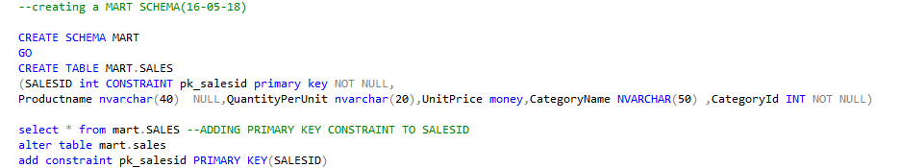
CREATING THE MART SCHEMA

Slide 21
TRANSFERING FROM ONE TABLE TO THE OTHER
TRANSFER PRODUCTS INTO DIMPRODUCT TABLE
We Have Made Use of Identity which is automatically taken as the primary key index

Slide 22
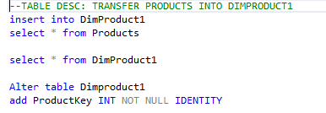
SNAPSHOT

Slide 23
NEED FOR A LOOKUP TABLE
We do not need the details of employees and customers. We just keep the consolidated data that the store manager needs to see and not for the user.
We keep the customerid and their corresponding salesid to keep a track one customer has ordered how many items on day to day basis.
From lookup table we get the customer details and sales details by joining the ids.
After that we create the outbound table which is basically the summary of all transactions in the 24-hour duration. It is basically a data warehouse.

Slide 24
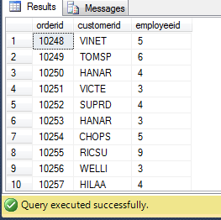
OUR REFERENCE LOOKUP TABLE

Slide 25
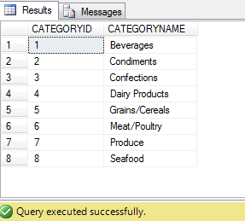
TABLES UNDER REFERENCE SCHEMA( CATEGORY)

Slide 26
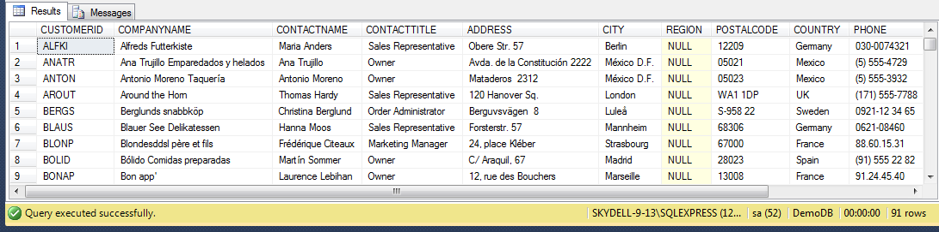
TABLES UNDER REFERENCE SCHEMA( CUSTOMER)

Slide 27
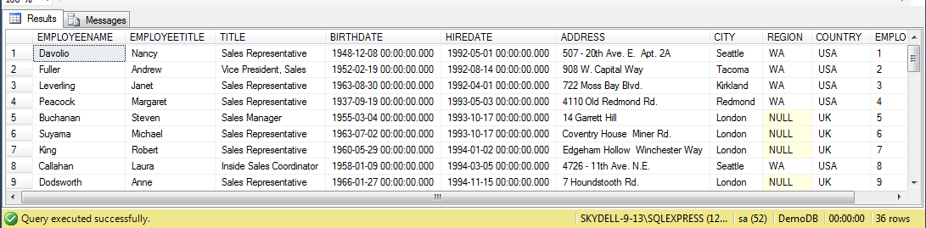
TABLES UNDER REFERENCE SCHEMA( EMPLOYEE)

Slide 28
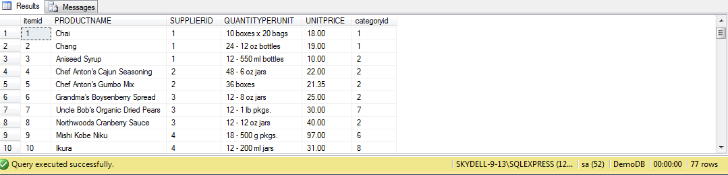
TABLES UNDER REFERENCE SCHEMA( PRODUCT)

Slide 29
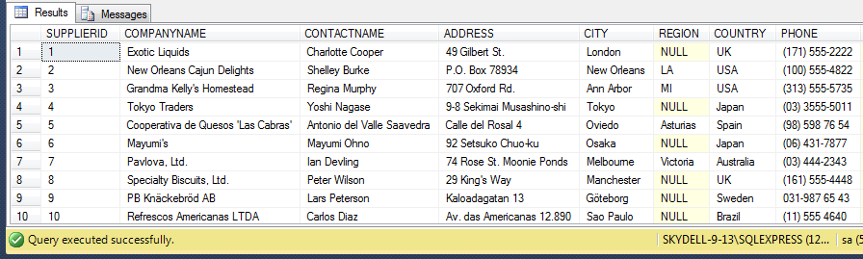
TABLES UNDER REFERENCE SCHEMA( SUPPLIER)

Slide 30
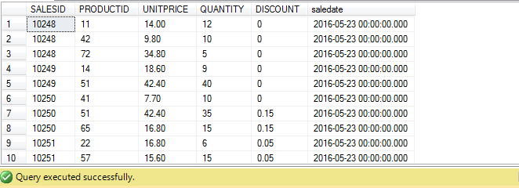
TABLES UNDER REFERENCE SCHEMA( SALES DETAILS)

Slide 31

CREATING THE OUTBOUND SCHEMA

Slide 32
WHAT IS STAGING?
A staging area, or landing zone, is an intermediate storage area used for data processing during the extract, transform and load (ETL) process. The data staging area sits between the data source(s) and the data target(s), which are often data warehouses, data marts, or other data repositories.

Slide 33
FUNCTIONS OF STAGING
One of the primary functions performed by a staging area is consolidation of data from multiple source systems.
The staging area and ETL processes it supports are often designed with a goal of minimizing contention within source systems.
Precalculation of aggregates, complex calculations and application of complex business logic may be done in a staging area to support highly responsive service level agreements (SLAs) for summary reporting in target systems.

Slide 34
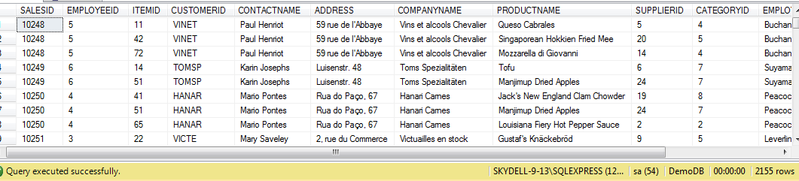
OUTBOUND TABLE

Slide 35
STAGING INTO OUTBOUND FROM VARIOUS DATA SOURCES IN REFERENCE

Slide 36
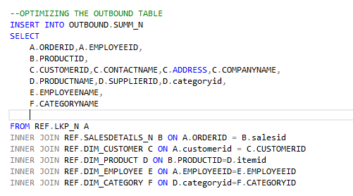
INSERTING INTO OUTBOUND(STAGING)

Slide 37
ANALYSIS FROM THE OUTBOUND
We use Analytical Functions like :
SUM()
MAX()
AVG()
COUNT
DENSE_RANK()

Slide 38
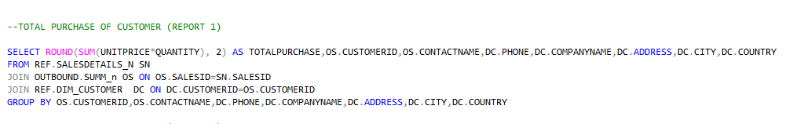
TOTAL PURCHASE OF CUSTOMER (REPORT 1)

Slide 39
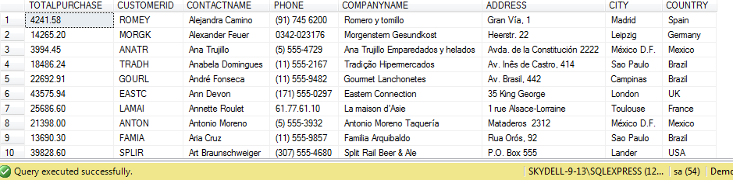
RESULT

Slide 40
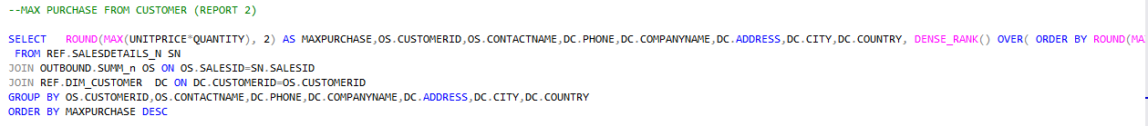
MAXIMUM PURCHASE(REPORT 2)

Slide 41
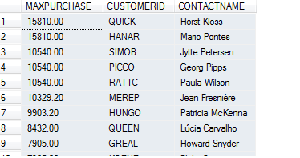
RESULT

Slide 42
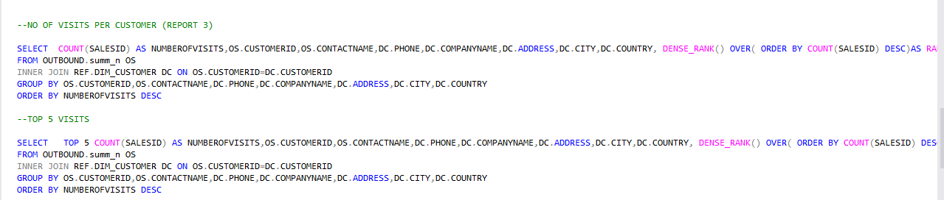
NUMBER OF VISITS PER CUSTOMER

Slide 43
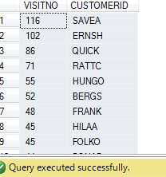
RESULT

Slide 44
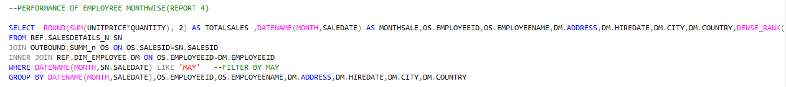
PERFORMANCE OF EMPLOYEE MONTHWISE(Filter by Month)

Slide 45
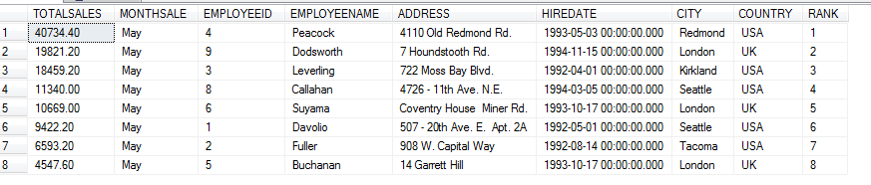
RESULT

Slide 46
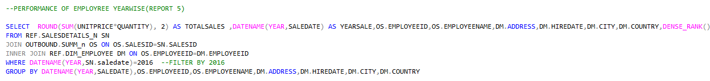
PERFORMANCE OF AN EMPLOYEE YEARWISE(Filter by Year)

Slide 47
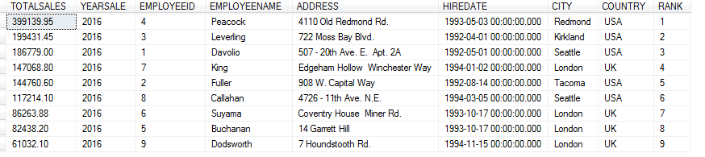
RESULT

Slide 48
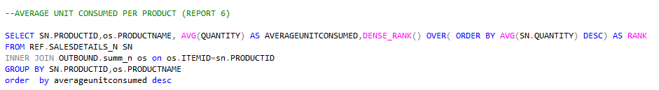
AVERAGE UNIT CONSUMED PER PRODUCT

Slide 49
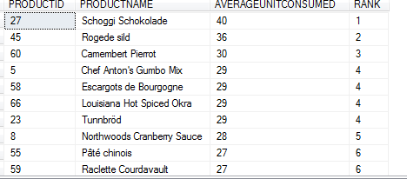
RESULT

Slide 50
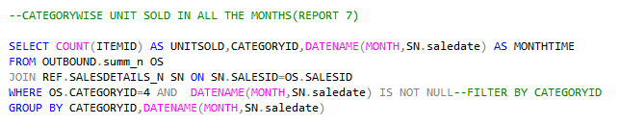
CATEGORYWISE UNIT SOLD IN ALL THE MONTHS (Filter By Category)

Slide 51
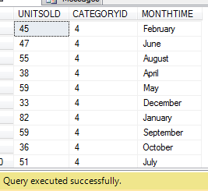
RESULT

Slide 52
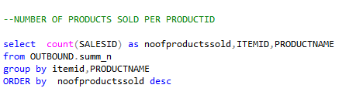
NUMBER OF ITEMS SOLD PER PRODUCT ID

Slide 53
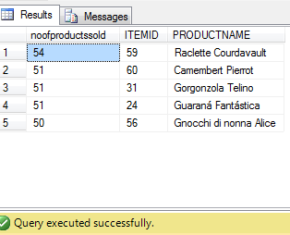
DISPLAYING THE TOP 5(Using TOP Number Query)

Slide 54
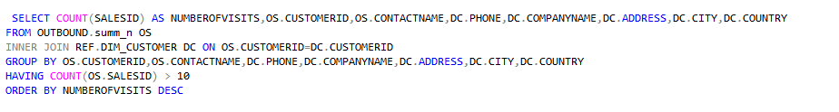
CUSTOMER DETAILS WITH MORE THAN 10 VISITS (Using HAVING)

Slide 55
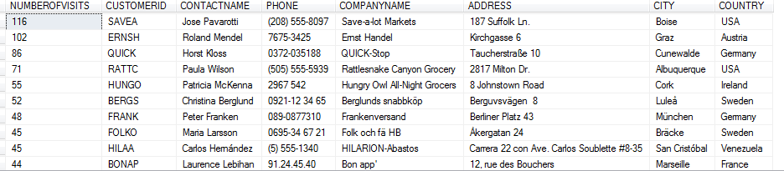
RESULT

Slide 56
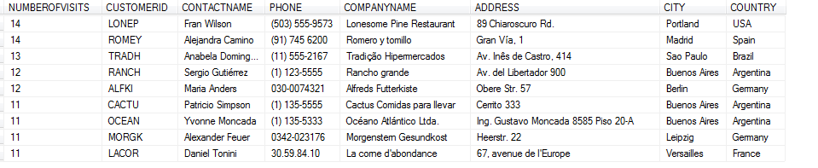
RESULT

Slide 57
STATISTICAL ANALYSIS
In the context of business intelligence (BI), statistical analysis involves collecting and scrutinizing every data sample in a set of items from which samples can be drawn. A sample, in statistics, is a representative selection drawn from a total population.

Slide 58
GOAL OF STATISTICAL ANALYSIS
The goal of statistical analysis is to identify trends. A retail business, for example, might use statistical analysis to find patterns in unstructured and semi-structured customer data that can be used to create a more positive customer experience and increase sales.

Slide 59
WHAT IS CORRELATION COEFFICIENT?
A correlation coefficient is a statistical measure of the degree to which changes to the value of one variable predict change to the value of another. In positively correlated variables, the value increases or decreases in tandem. In negatively correlated variables, the value of one increases as the value of the other decreases.

Slide 60
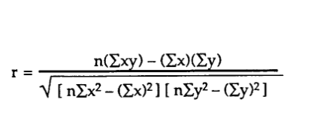
FORMULA FOR CORRELATION COEFFCIENT

Slide 61
SQL QUERY

Slide 62
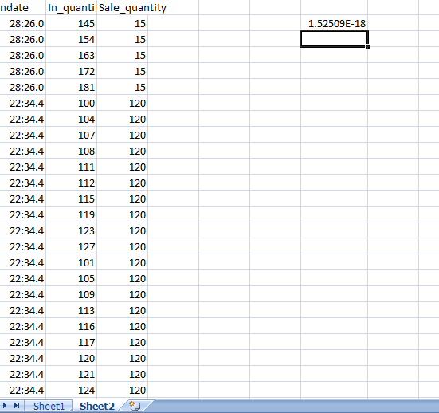
SNAP FROM MS-EXCEL

Slide 63
INFERENCE FROM ANALYSIS
We get the total sales of an employee, both month wise and year wise with respect to the parameter we set. This introduces us to the concept of Key Performance Indicator.(Rank wise listing the employee name).
From this analysis the HR can decide whether Rank 1 Employee’s salary should be increased in the coming month/year or not.

Slide 64
INFERENCE
The Store Manager can decide whether he/she will give special coupons/offers to the customer who has the highest purchase of items.
The Store can send updates / notifications to the customers who frequently visit the store/ has highest purchase in that store on new stocks.

Slide 65
INFERENCE
From the average units consumed per product, the manager can decide which item categories were sold the most. Next time, he/she can bring in more stocks of that category.
Similarly, many such references can be drawn for decision-making.

Slide 66
MY LEARNING EXPERIENCE:
Knowledge of OLTP And OLAP and the basic differences between them
Implementation of dimensional models, query processing and analysing.
Concept of Common Table Expression
Analysis eventually leads to an understanding of how the business is running and what should be done for its improvement
Introduction to statistical analysis for forecasting

Slide 67
THANK YOU
ANUBHAV JANA

